Slide 1
IMAGE CATOONIZATION
Team Id :- 4039
College Name :- Sarvajanik College of Engineering and Technology Surat
Team Mentor :- Bassar Patel
Members :- Afsinbanu Saeed – IC (Team Leader)
Mariya Tohfafarosh - IC
Ansh Shah – EL
Avneet Kashyap - EL

Slide 2
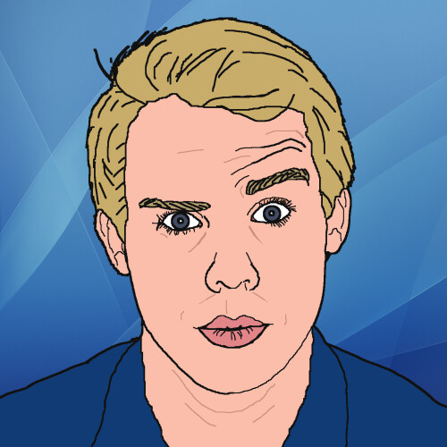
AGENDA
Our main objective of this project is to Cartoonify an image of any object or human being. The image can be converted into either coloured or black and white cartoon.

Slide 3
PROJECT OVERVIEW
In this Project, we implemented one of the exciting and thrilling applications of Machine Learning by building an interesting application that Cartoonifies the image provided to it.
We build this by using OpenCV library in Python Programming.
OpenCV is an open-source library in python that is used mainly for computer vision tasks in the areas of machine learning and artificial intelligence.

Slide 4
PROJECT OVERVIEW
First we import necessary packages and read the image
Then we create edge mask for finding and identifying the edges of the image.
Perform Colour Quantization technique for reducing the colour palette of the image.
Then for reducing the noise and getting blurred effect, we use the bilateral filter.
Lastly, we combine the edges to get a quantized result and cartoon like effect on our image.

Slide 5
WHO ARE THE USERS?
General Public
Cartoon Animators
Comic Writers

Slide 6
LIBRARIES USED
Python: We use python as a programming language for building the application.
cv2: We use cv2 for image processing.
NumPy: Mainly NumPy is used for dealing with arrays. Here the images that we use are stored in the form of arrays. So for that, we use NumPy.
Matplotlib: Matplotlib is used for visualization purposes. Here we plot the images using matplotlib.

Slide 7
BLOCK DIAGRAM
UPLOAD
GRAYSCALE
SMOOTHENING
RETRIEVE EDGES
MASK IMAGE
CARTOON EFFECT

Slide 8
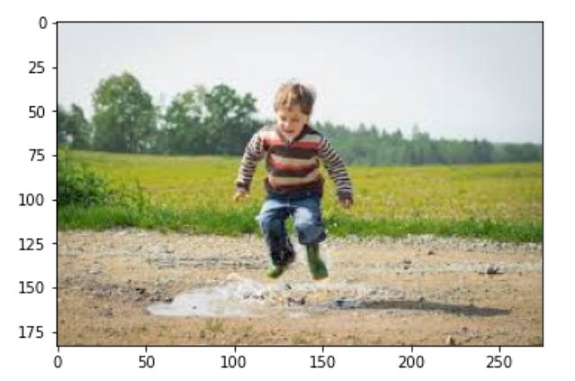
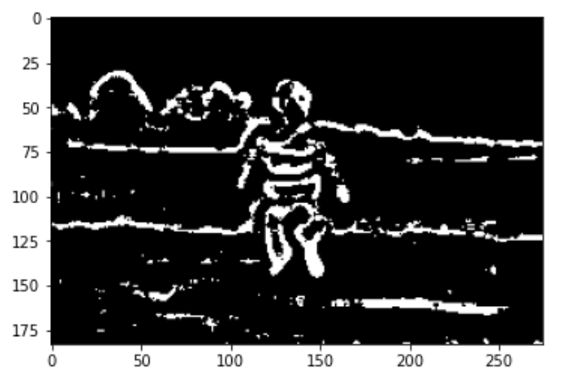
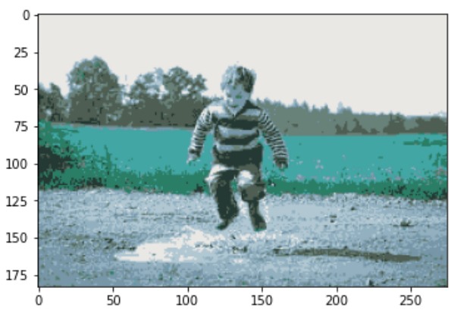
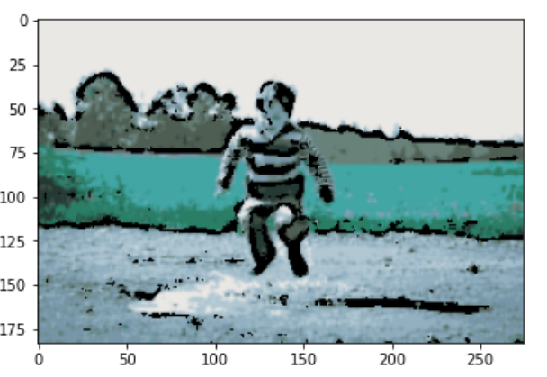
RESULTS
Demo/Github Link :

Slide 9
CONCLUSION
Finally, after going through all the transitions, we will get the output image which will look like a Cartoon.
The Cartoonified Image can then be downloaded or uploaded and used as the user sees fit.

Slide 10
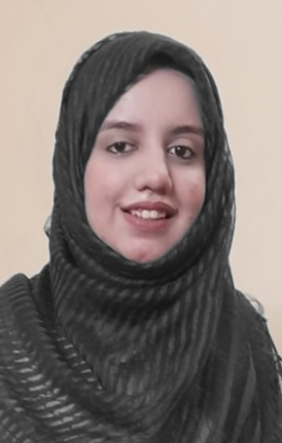
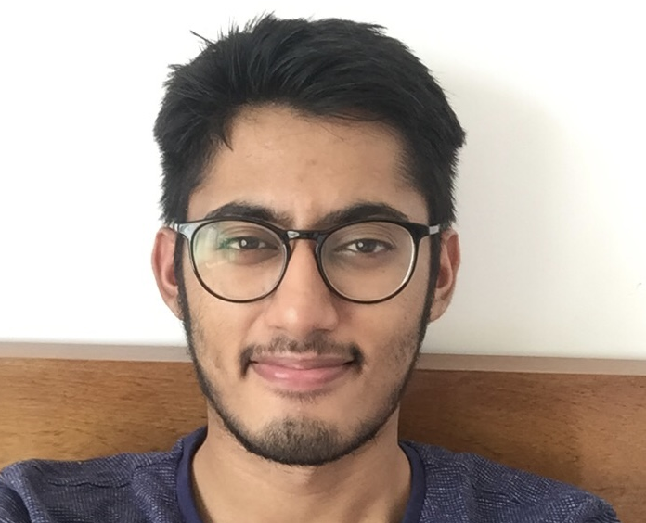
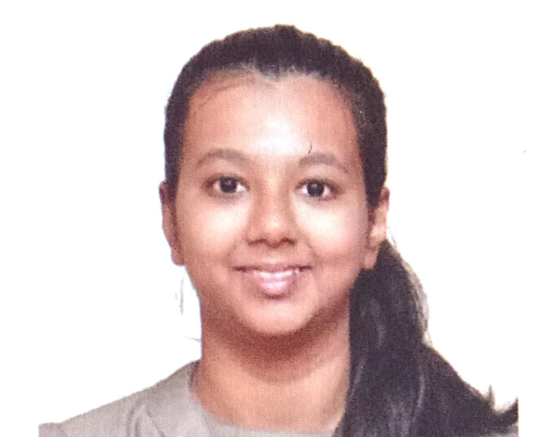
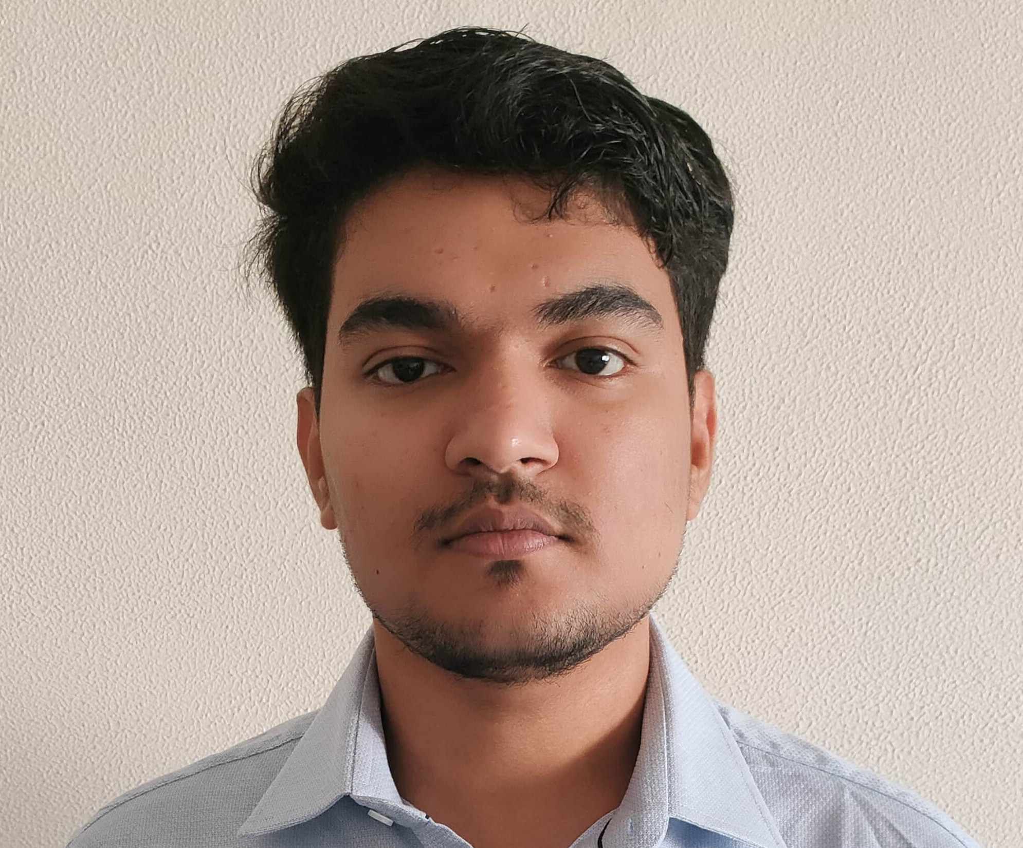
MEET OUR TEAM
Afsinbanu Saeed
Ansh Shah
Mariya Tohfafarosh
Avneet Kashyap

